Slide 1


INVESTIGATING OVER-QUANTIZATION EFFECTS IN DIGITAL IMAGES
SIMATS ENGINEERING
SAVEETHA INSTITUTE OF MEDICAL AND TECHNICAL SCIENCES
Technical presentation
ITA0506_SLOT D_COMPUTER VISION
PRESENTED BY:
K. Manoj Kumar(192472395)

Slide 2
Introduction
What is Quantization?
Reduces the number of intensity or color levels in an image.
Used to reduce storage size and improve compression.
What is Over-Quantization?
Excessive reduction of intensity levels.
Leads to noticeable loss of image quality.
Effects of Over-Quantization
Loss of fine image details.
Color banding (visible color/intensity steps).
Reduced contrast and sharpness.
Distorted edges and textures.
Visual artifacts appear in the image.

Slide 3
LIMITATIONS
Permanent loss of image information.
Lower accuracy in image analysis and object detection.
Poor quality for medical and satellite imaging.
Difficult to recover the original image.
Not suitable when high visual quality is required.
Excessive compression reduces user experience.

Slide 4
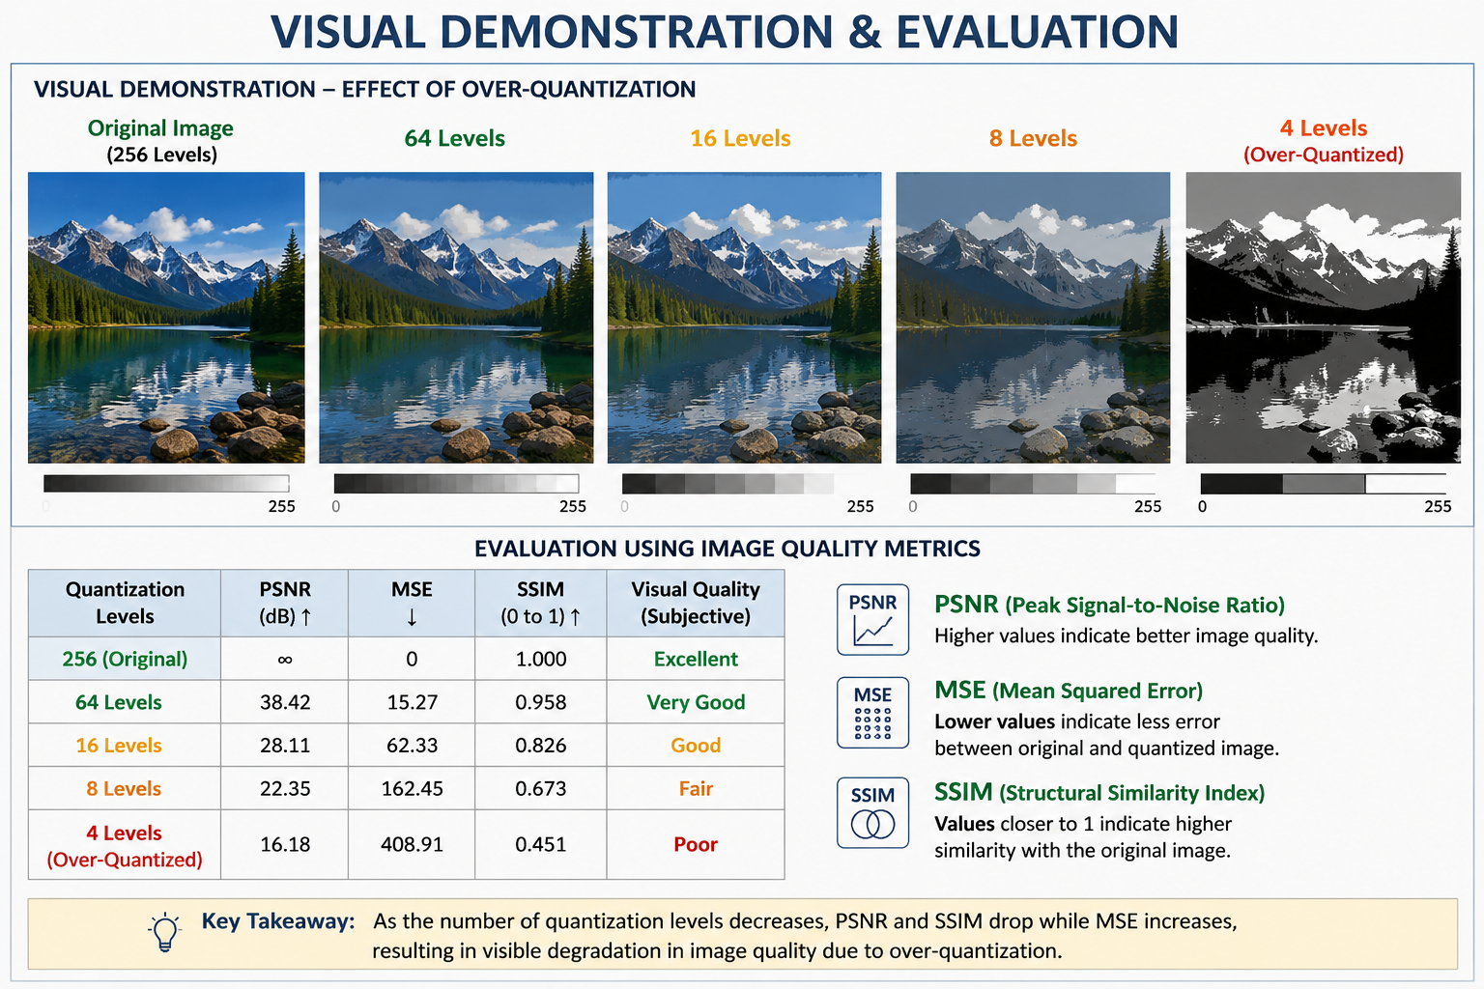
Visual Demonstration & Evaluation
Visual Comparison
Original Image
64-Level Quantized Image
16-Level Quantized Image
4-Level Quantized Image
Quality Metrics
PSNR (Peak Signal-to-Noise Ratio): Higher value indicates better quality.
MSE (Mean Squared Error): Lower value indicates less error.
SSIM (Structural Similarity Index): Value closer to 1 indicates higher similarity to the original image.

Slide 5
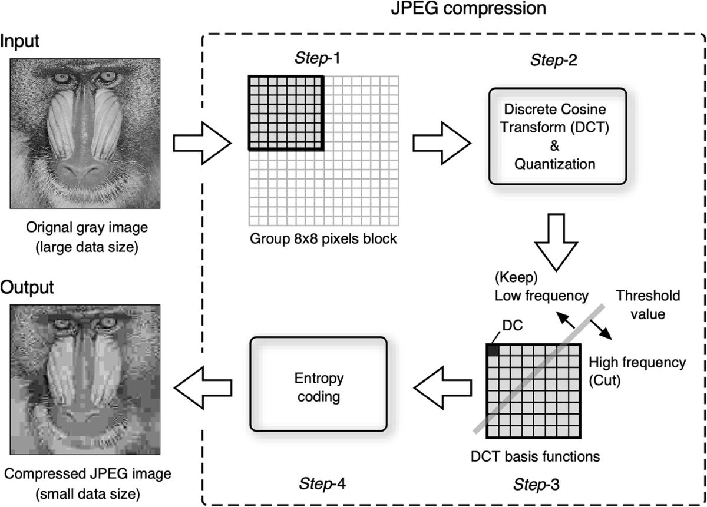
Applications of Quantization
Image Compression – Reduces image file size for efficient storage and transmission.
Medical Imaging – Used in X-rays, MRI, and CT scans to process and store images.
Satellite Imaging – Compresses large remote sensing images for faster analysis.
Computer Vision & AI – Helps optimize image processing and deep learning models.
Multimedia Systems – Used in digital cameras, video streaming, and image editing software.

Slide 6
Conclusion
Key Findings
Quantization helps reduce storage and transmission costs.
Over-quantization significantly reduces image quality.
Visual demonstrations clearly show detail loss and color banding.
A balance between compression and image quality is essential.
Future Scope
Use adaptive or AI-based quantization techniques.
Optimize compression while preserving image quality.

